Slide 1
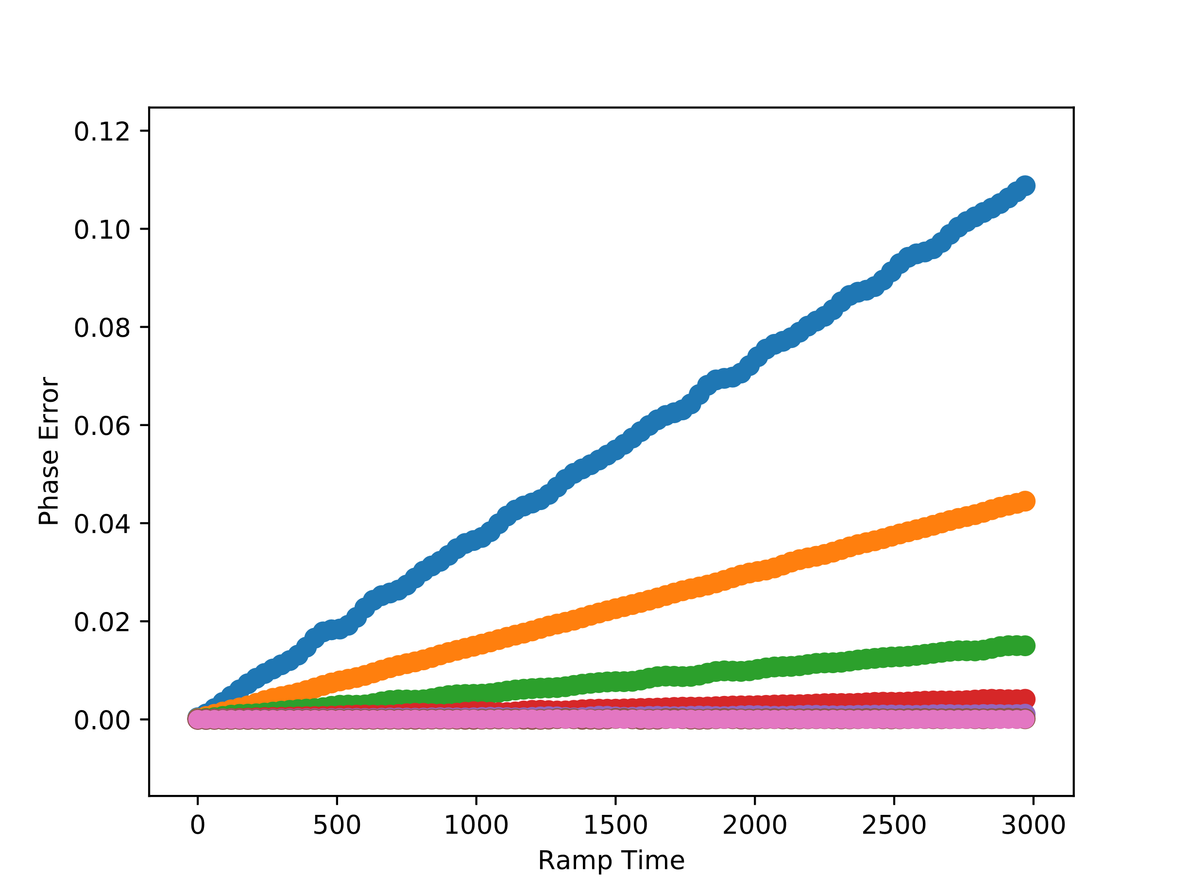
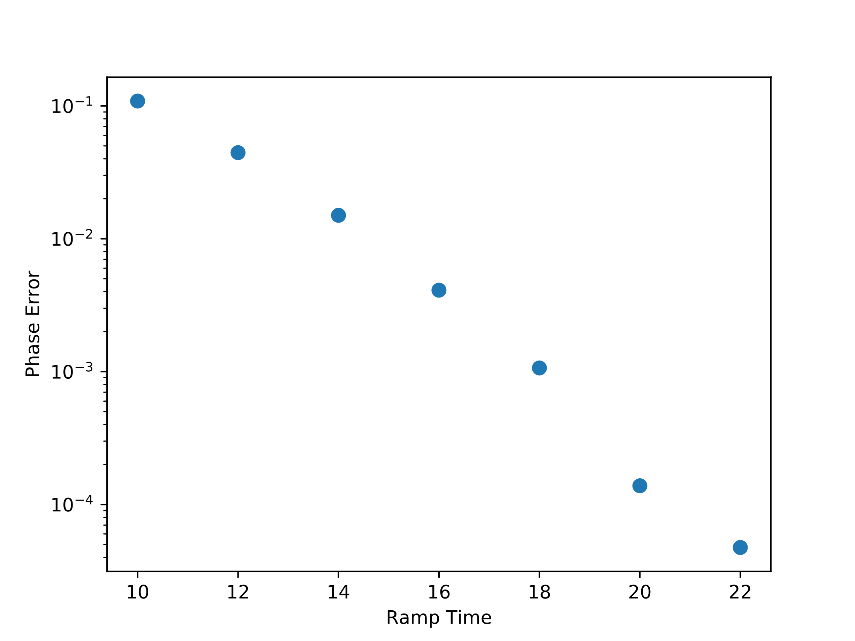
$μ$=0.2, J=1, $Δ=0.7, Vmax=0.1, tr=500, tw=3000, dt=0.01, BD=40, N=2, α=0$
L=10
L=12
L=14
L=16
L=18
L=20
L=22

